Slide 1
Moiré Ferroelectrics and Neuromorphic Computing Applications
Bumbia, Amal;
Lee, Kyoung Pyo;
Kim, Dongseob;
Li, Xiaoqin
Department of Physics UT Austin

Slide 2
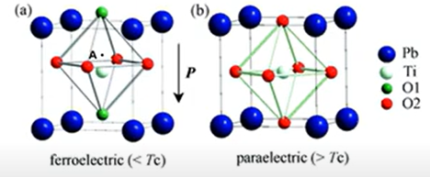
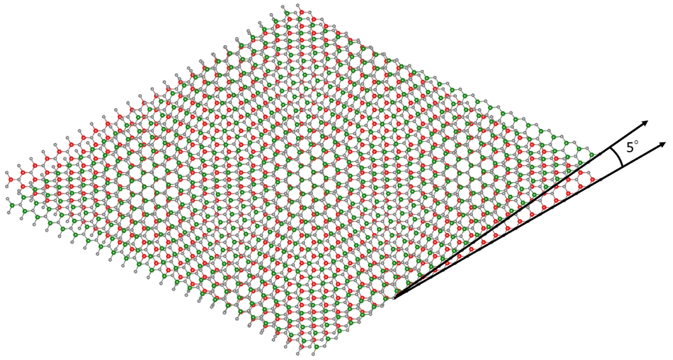
Moiré vs. Conventional Ferroelectrics
Ferroelectrics: Materials with spontaneous polarization; can be manipulated via external electric field
Moiré Materials: Stacked 2D materials with twist angle; generates new properties
1

Slide 3
Moiré vs. Conventional Ferroelectrics
Conventional
tuning polarization
depends on deviation of the atom at the center of unit cell
Moiré
Structural consequence
Domain network effects
Linked — altering one atom impacts the whole structure
Local switching
Devices :)
Ferroelectricity ._.
2

Slide 4
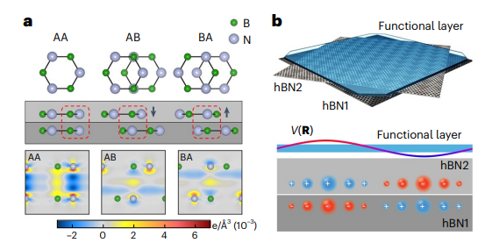
t-hBN
(twisted hexagonal boron nitride)
Net dipole moment for regions!
Kim, D.S., Dominguez, R.C., Mayorga-Luna, R. et al. Electrostatic moiré potential from twisted hexagonal boron nitride layers. Nat. Mater. 23, 65–70 (2024). https://doi.org/10.1038/s41563-023-01637-7
3

Slide 5
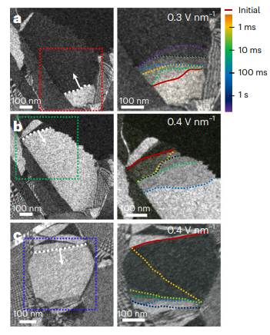
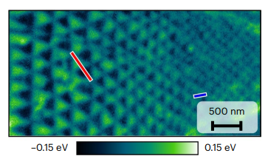
Ferroelectric Domains
Different regions of a material with different polarizations
Separated by domain walls — boundaries of enhanced electrical conductance
Twist angle determines size of domains in general (inversely related)* - stress and strain cause deformations
https://doi.org/10.1038/s41563-023-01595-0
4
https://doi.org/10.1038/s41563-023-01637-7
Notes:
White lines + arrows = domain walls and direction of motion ; right is after E field is applied, shows domain walls moving away from their initial position

Slide 6
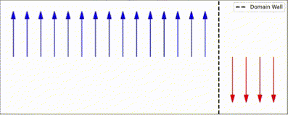
Local vs. Nonlocal Switching
local domain switching with voltage application —
domain walls are shifting, and the new region they annex is ascribed the polarization (domain wall gerrymandering)
5
Notes:
Is the applied voltage an impulse or a constant voltage over time — what does the switching mean – does the polarization from every domain align or do they all flip relative to what they originally were? What does destroying the periodicity mean?

Slide 7
Expected switching behavior:
6

Slide 8
But in t-hBN, applying voltage to a single region causes switching over the entire sample! Why…?
7

Slide 9
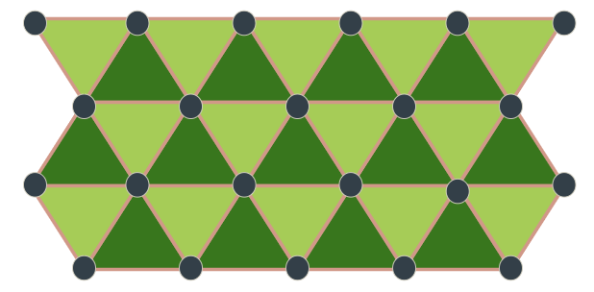
The answer: Domain wall dynamics
Domain walls no longer “translate”
— they expand/contract about fixed points
Change size
Domain wall interconnectivity influences global behavior
Periodicity is erased — restores back to original state like a rubber band
Memory is temporarily lost
8
Notes:
Philip king

Slide 10
What can we do with this material?
Make devices.
For what?
Neuromorphic computing!
What is that?
9

Slide 11
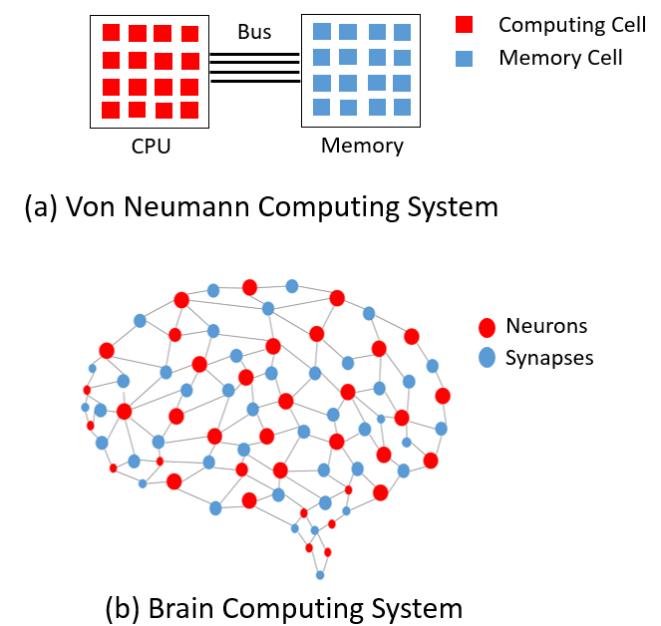
What is neuromorphic computing?
Von Neumann bottleneck - memory and processing are separate units so data needs to be carried back and forth between them
There is transfer latency between memory and central processor — “memory wall”
10

Slide 12
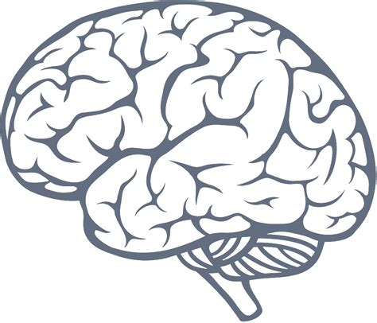
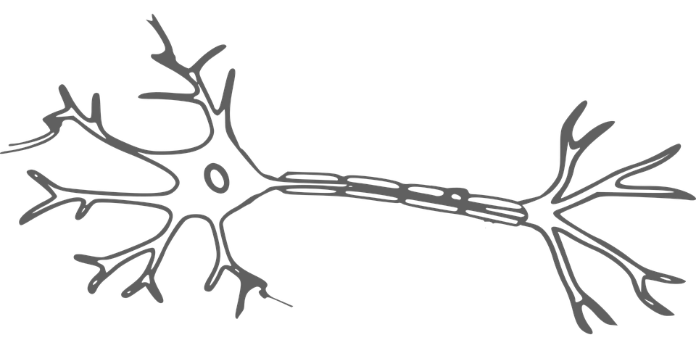
What is neuromorphic computing?
hardware and algorithms that efficiently process information by mimicking the functionality of the human brain — create artificial neurons and synapses
computations processed where the data is located — improved processing speed
11

Slide 13
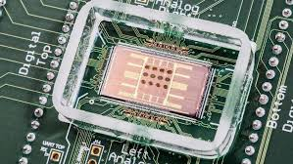
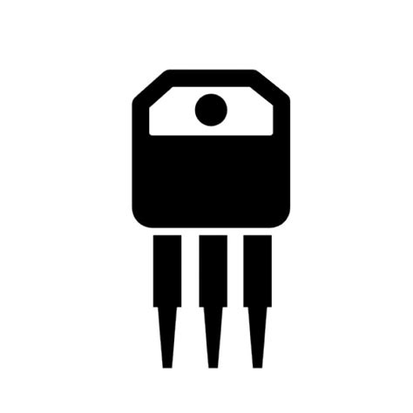
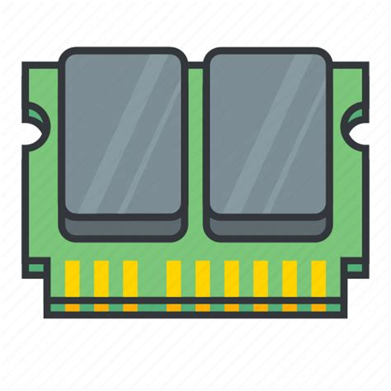
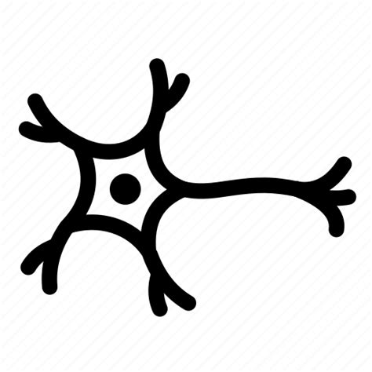
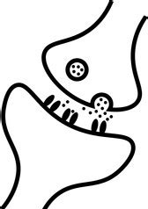
But there’s a problem…
complementary metal-oxide-semiconductor (CMOS) chip
transistors —-> neuron
brain has ~ 10000 synapses per neuron — cannot replicate on CMOS
memories —-> synapse
need chips with MILLIONS of artificial neurons and synapses
How??
12

Slide 14
Ferroelectrics in Neuromorphic Computing
Advantages
ultra-fast write/read speed
ultra-low power consumption
long retention
high endurance
practical implementation of high-performance synaptic devices
non-volatile memory
13
Notes:
explore other potential ferroelectric materials, which have atomic-scale thickness and can be switched using ultra-low voltage — what is thickness of thbn
Switching time?

Slide 15
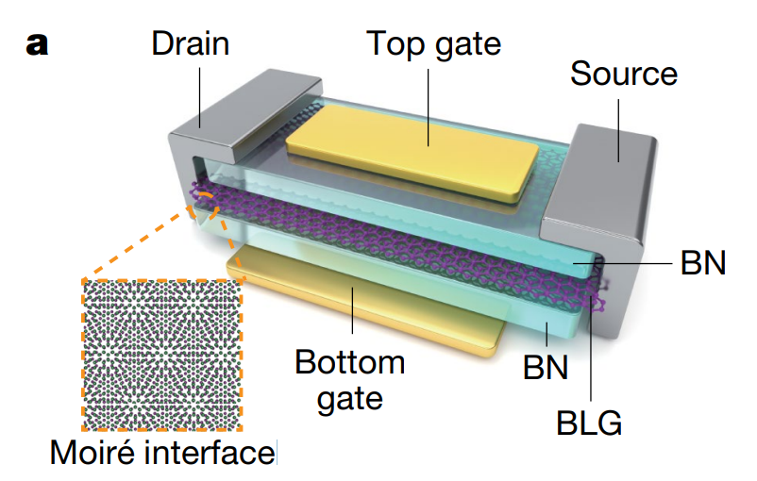
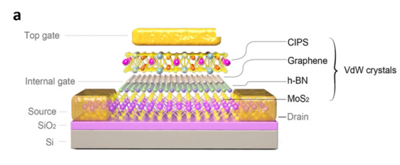
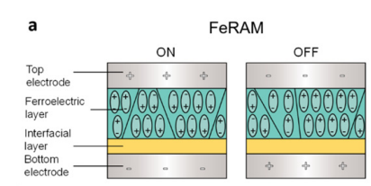
FeRAM : ferroelectric memristor with MFM sandwich; two-terminal
FeFET : ferroelectric field effect transistor; ferroelectrics serve as the gate dielectric in a three-terminal transistor structure
FTJ : two-terminal device with a ferroelectric material sandwiched between two electrodes
14

Slide 16
But ferroelectric devices already exist! What’s special about the t-hBN?
Global switching behavior!
15

Slide 17
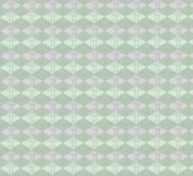
Applications of Nonlocal Switching To Neuromorphic Computing
use t-hBN as ferroelectric layer in FeRAM, FTJ, or FeFET - like device
device with one point of contact to an external electric field; plating is not necessary
temporary store for memory due to recoverable erasure in moiré periodicity
Lower energy consumption
Time dependency
Two points of contact for electrodes
electrode
t-hBN
16

Slide 18
Future Efforts
What causes the “forgetting” and “recovering” of periodicity? Is it a consequence of the moiré structure? Does the capacity for domain walls to store information play a role?
Why is non-local switching happening? How do domain network dynamics contribute to this? Is synaptic behavior a sufficient explanation?
What other ferroelectrics can exhibit non-local switching?
17

Slide 19
Acknowledgements
I would like to thank Kyoung Pyo Lee and Dr. Xiaoqin Li for giving me the opportunity to work on this project.

Slide 20
Extra Slides

Slide 21
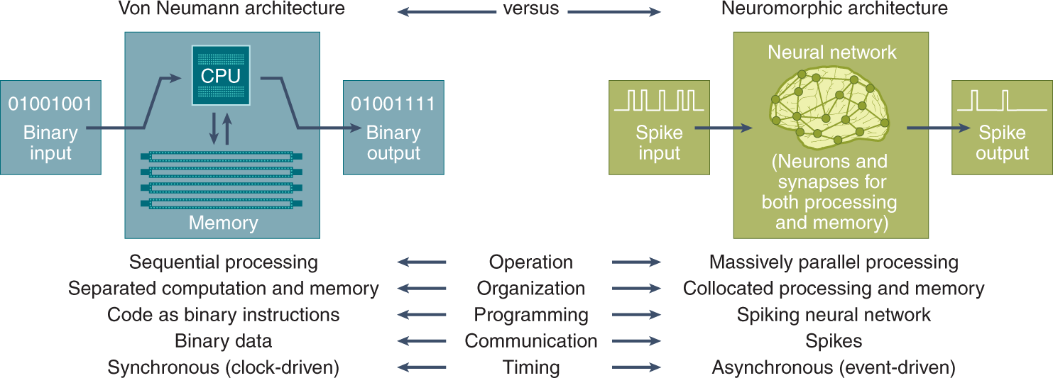

Slide 22
Brains…
have ultra low power consumption (on the order of 20 W) compared to supercomputers (consumes on the order of 1000 kWh - this is a 6 YEAR energy budget for a brain)
store memory, learn with few examples and from experience
have direct access to memory via synapses
have high plasticity due to many adaptive synapses

Slide 23
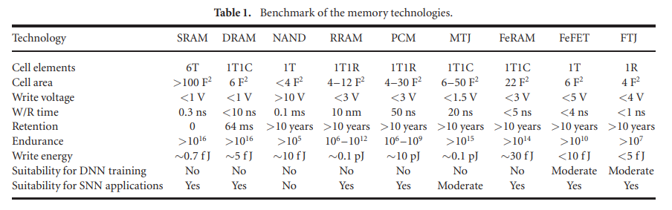

Slide 24
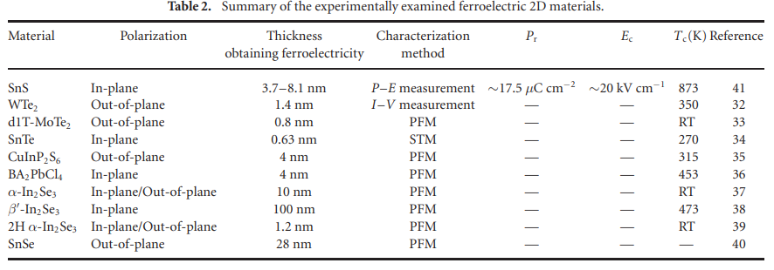

Slide 25
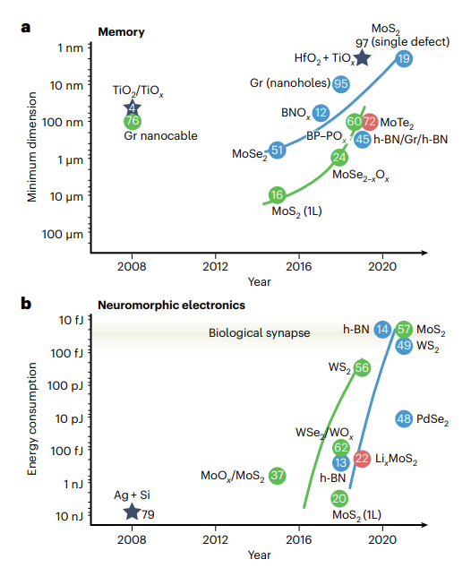
Part of emulating a synapse means to ensure that your device is capable of short and long term plasticity, spike-timing dependent plasticity, and heterosynaptic plasticity.
Artificial synapses can update and memorize internal conductivity known as synaptic weight in response to external stimuli.
Li, M., Liu, H., Zhao, R. et al. Imperfection-enabled memristive switching in van der Waals materials. Nat Electron 6, 491–505 (2023). https://doi.org/10.1038/s41928-023-00984-2

Slide 26
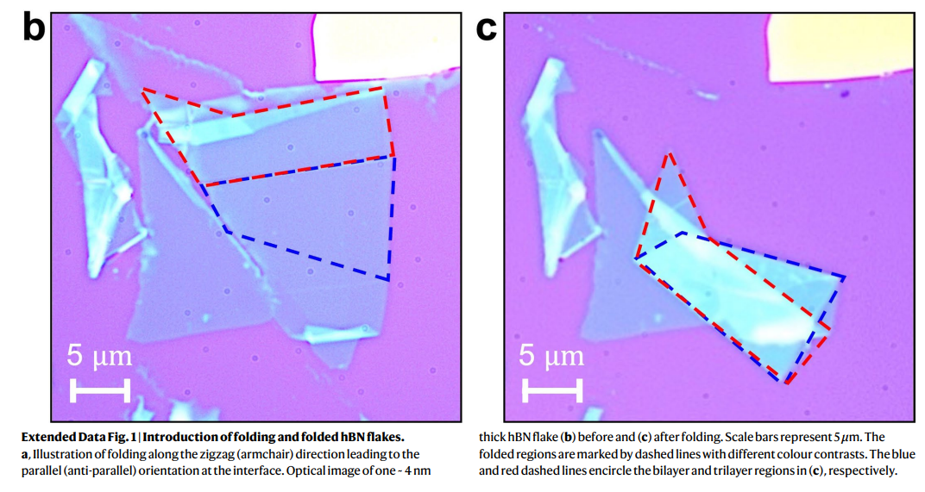
Kim, D.S., Dominguez, R.C., Mayorga-Luna, R. et al. Electrostatic moiré potential from twisted hexagonal boron nitride layers. Nat. Mater. 23, 65–70 (2024). https://doi.org/10.1038/s41563-023-01637-7

Slide 27
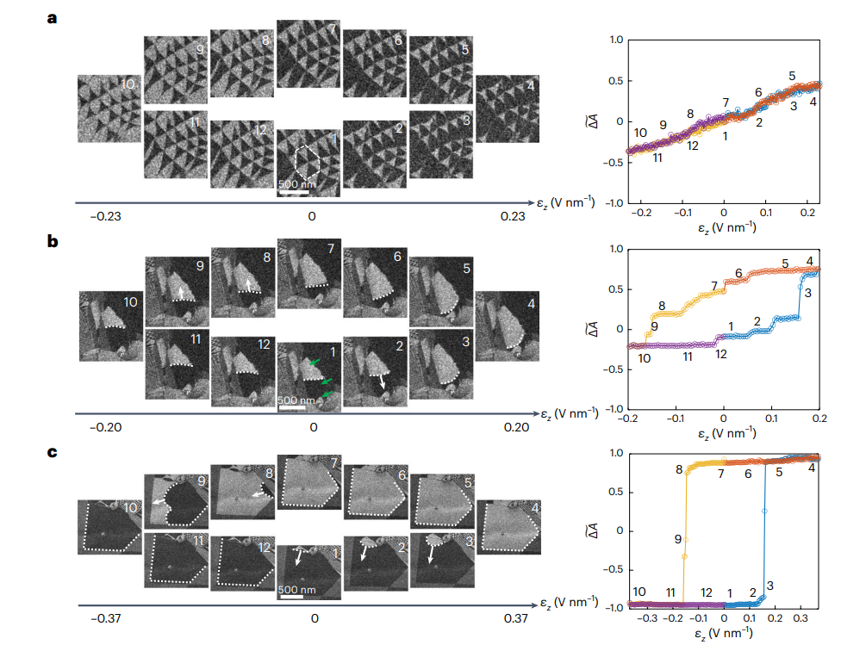
White lines show domain wall + direction of motion
Plots of normalized polarization vs. voltage during sweep
Ko, K., Yuk, A., Engelke, R. et al. Operando electron microscopy investigation of polar domain dynamics in twisted van der Waals homobilayers. Nat. Mater. 22, 992–998 (2023). https://doi.org/10.1038/s41563-023-01595-0

